Slide 1
Predicate Logic Conti….
Professor Dr. A K M Akhtar Hossain
Dept. of CSE, RU.

Slide 2
Properties of Statements:
Satisfiable: A statement is satisfiable if there is some interpretation for which it is true.
Contradiction: A sentence is contradictory (unsatisfiable) if there is no interpretation for which, it is true.
Valid: A sentence is valid if it is true for every interpretation.
Equivalence: Two sentences are equivalent if they have the same truth value under every interpretations.

Slide 3
Conti…
Logical Consequences: A sentence is a logical consequence of another if it is satisfied by all interpretations which satisfy the first.
A valid statement is satisfiable, and a contradictory statement is invalid, but the converse is not necessarily true.

Slide 4
Example: On The above definitions:
P is satisfiable but not valid since an interpretation that assigns false to P assigns false to the sentence P.
P V ~P is valid since every interpretation results in a value of true for (P V ~P ).
P & ~P is a contradiction since every interpretation results in a value of false for (P & ~P).

Slide 5
Conti…
P and ~(~P) are equivalent since each has the same truth values under every interpretation.
P is a logical consequence of (P & Q) since any interpretation for which (P & Q) is true, P is also true.

Slide 6
Theorem
Theorem 4.1: The sentence s is a logical consequence of s₁ , s₂ , ...... , s_{n} if and only if s₁ & s₂ & s₃ . . . . & s_{n} → s is valid.
Proof: Theorem 4.1 can be seen by first noting that if s is a logical consequence of s₁ , s₂ , .......... , s_{n} , then for any interpretation I in which s₁ & s₂ & s₃ , ..... . &s_{n} → s is true.
on the other hand, if s₁ & s₂ & s₃ , .... & s_{n} →s is valid, then for any interpretation I if s₁ & s₂ & s₃ , ..... . &s_{n} is true, s is also true.

Slide 7
Theorem
Theorem 4.2: The sentence s is a logical consequence of s₁ , s₂ , ...... , s_{n} if and only if s₁ & s₂ & s₃ , .... & s_{n} & ~s is inconsistent.
Proof: The proof of theorem 4.2 follows directly from theorem 4.1 since s is a logical consequence of s₁ , s₂ , ...... , s_{n} if and only if s₁ & s₂ & s₃ , ..... . &s_{n} → s is valid, that is, if and only if ~(s₁ & s₂ & s₃ , ..... . &s_{n} → s ) is inconsistent.

Slide 8
Conti …..
But
~(s₁ & s₂ & s₃ , ..... . &s_{n} → s ) = ~(~(s₁ & s₂ & s₃ , ..... . &s_{n} ) V s)
[By Conditional Elimination]
= ~~(s₁ & s₂ & s₃ , ..... . &s_{n} ) & ~s)
[ By De Morgan’s Law]
= s₁ & s₂ & s₃ , ..... . &s_{n} & ~s
When s is a logical consequence of s₁ , s₂ , ...... , s_{n} , the formula s₁ & s₂ & s₃ , ..... . &s_{n} → s is called a theorem, with s is the conclusion.
When s is a logical consequence of the set S = {s₁ , s₂ , ...... , s_{n} } we will also set S logically implies or logically entails S , written Sⱶs .

Slide 9
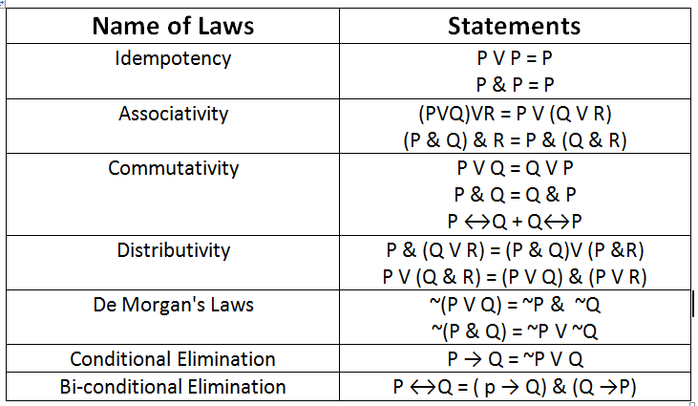
Table 4.2 lists some of the important laws of PL (Some Equivalence Laws)

Slide 10
Example
Show that P→Q is equivalent to ~PVQ and that P↔Q is equivalent to the expression (P→Q)&(Q→P).
The truth table 4.3 is given bellow.

Slide 11
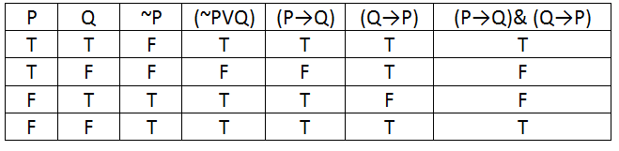
TABLE 4.3 : Truth table for equitant sentences

Slide 12
Inference Rules
The inference rules of PL provide the means to perform logical proofs or deductions.
Few Such Rules are as follows:
Modus ponens
Chain Rule

Slide 13
Modus Ponens:
From P and P → Q infer Q. This sometimes written as
P
P → Q
Q

Slide 14
Example For Modus Ponens:
Given: (Joe is a father)
And: (Joe is a father) → ( Joe has a child)
Conclude: (Joe has a child)

Slide 15
Chain Rule
Form P → Q and Q→ R, infer P→R.
Or
P → Q
Q → R
P → R

Slide 16
Example for Chain Rule
Given: (programmer likes LISP)→ (programmer hates COBOL)
and : (programmer hates COBOL) → (programmer likes recursion)
Conclude: (programmer likes LISP)→ (programmer likes recursion)
LISP → List Processing
COBOL → Common Business Oriented Language
Prolog → Programming in Logic

Slide 17
Assignment-3
1. Construct a truth Table for the expression
(A & (A V B)).
2. Determine whether each of the following sentences is
(a) Satisfiable
(b) Contradictory
(c) Valid

Slide 18
Assignment-3 Conti…
(i) S₁: (P & Q) V ̃(P & Q)
(ii) S₂: (P V Q )→ (P & Q)
(iii) S₃: (P V Q)→ R V ̃Q
(iv) S₄: (P V Q)& (PV ̃Q) V P
(v) S₅: P → Q→ ̃P
(vi) S₆: P V Q & ̃P V ̃Q &P

Slide 19
Thanks

